Slide 1
Final Project Proposal
Group 11
313551088 楊右宇 Yu-Yu Yang,
313551072 郭建廷 Jian-Ting Guo,
313551019 羅凱威 Kai-Wei Luo

Slide 2
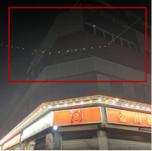
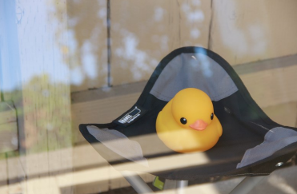
Introduction
There are two common problem for photography :
Mirror reflection
Reflective flare
reflective flare
mirror reflection

Slide 3
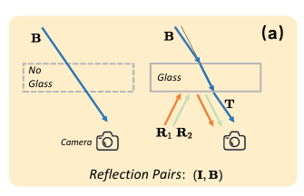
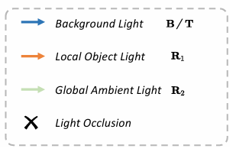
Introduction
Mirror reflection

Slide 4
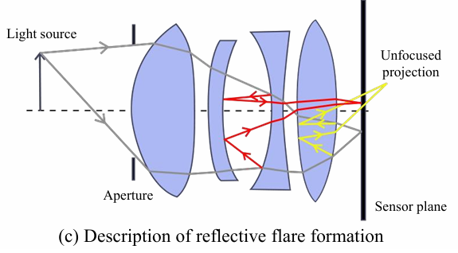
Introduction
Reflective flare

Slide 5
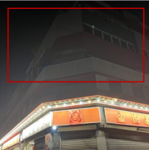
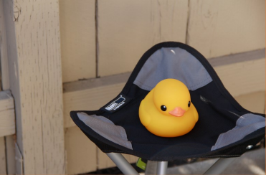
Problem Definition
Input
Images affected by mirror reflections or reflective flare
Output
Images with reflections and reflective flares removed.
reflective flare
mirror reflection

Slide 6
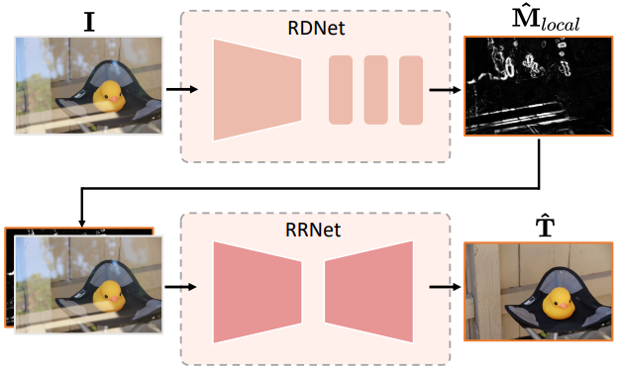
Related Work
Mirror reflection removal
Divide-and-conquer framework
Reflection Detection Net
EfficientNet
Reflection Removal Net
NAFNet
Zhu, Yurui, et al. "Revisiting Single Image Reflection Removal In the Wild." Proceedings of the IEEE/CVF Conference on Computer Vision and Pattern Recognition. 2024.

Slide 7
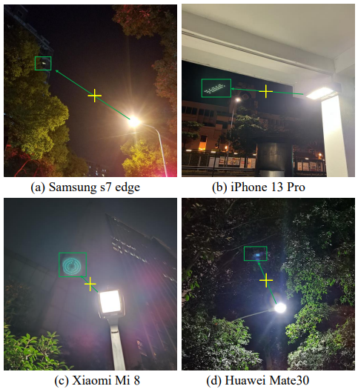
Related Work
Reflective Flare Removal
It is theoretically impossible to obtain a ground truth image with the reflective flare removed from the same picture.
Reflective flare typically occurs at the point in the image that is symmetrically opposite the brightest light source relative to the center of the lens.
Dai, Yuekun, et al. "Nighttime smartphone reflective flare removal using optical center symmetry prior." Proceedings of the IEEE/CVF Conference on Computer Vision and Pattern Recognition. 2023.
Notes:
Reflective flare occurs due to physical phenomena within the lens, so it is theoretically impossible to obtain a ground truth image with the reflective flare removed from the same picture.
It is theoretically impossible to obtain a ground truth image with the reflective flare removed from the same picture.

Slide 8
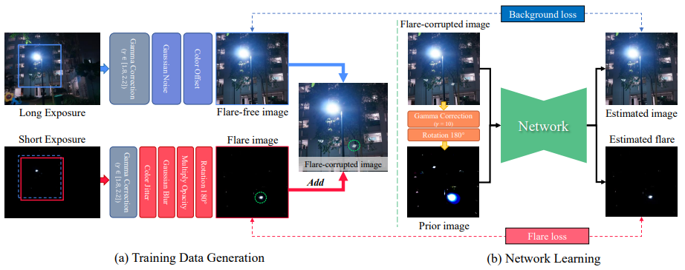
Related Work
Reflective Flare Removal
Dai, Yuekun, et al. "Nighttime smartphone reflective flare removal using optical center symmetry prior." Proceedings of the IEEE/CVF Conference on Computer Vision and Pattern Recognition. 2023.

Slide 9
Related Work
Reflective Flare Removal
Dai, Yuekun, et al. "Nighttime smartphone reflective flare removal using optical center symmetry prior." Proceedings of the IEEE/CVF Conference on Computer Vision and Pattern Recognition. 2023.

Slide 10
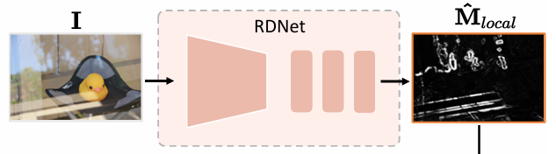
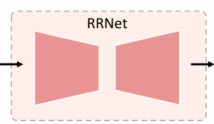

Our Solution
Our Solution is composed of two phases:
1. Extract reflection/reflective flare mask from the input
2. Restore the image using the input and the mask
Phase 1.
To detect the defect
Phase 2.
To restore the image

Slide 11
Our Solution
In Phase 1.
We propose a new model FDNet to extract flare mask
Use RDNet[1] to extract reflection mask
Input
Flare Mask
FDNet
Input
Reflection mask

Slide 12
Our Solution
In Phase 2.
Concatenate Flare Mask and RD-mask, make it into 5-channel input
Apply RRNet[1] to restore clear image
Concat mask and intput
Output

Slide 13
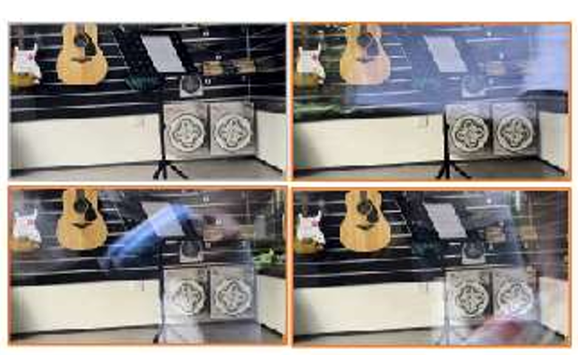
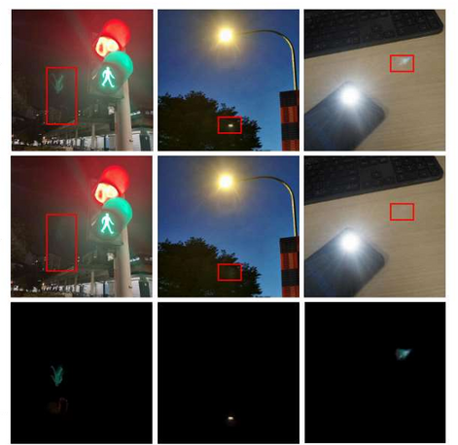
Data Processing
Reflection Removal in the Wild (RRW dataset)[1]
Contain over 14950 high resolution real-world reflection pairs.
BracketFlare (BF dataset)[2]
Contains 480 diverse and realistic reflective flare patterns.

Slide 14
Data Processing
In Phase 1.
we will train FDNet, RDNet indivisually.
FDNet will be trained using the BF dataset.
RDNet will be trained using the RRW dataset.
BF dataset
Input
F-Mask
FDNet
Input
R-Mask
RRW dataset

Slide 15
Data Processing
In Phase 2.
Due to we do not have a dataset that simultaneously contains issues of both reflections and flare.
???
Concat mask and intput
Output

Slide 16
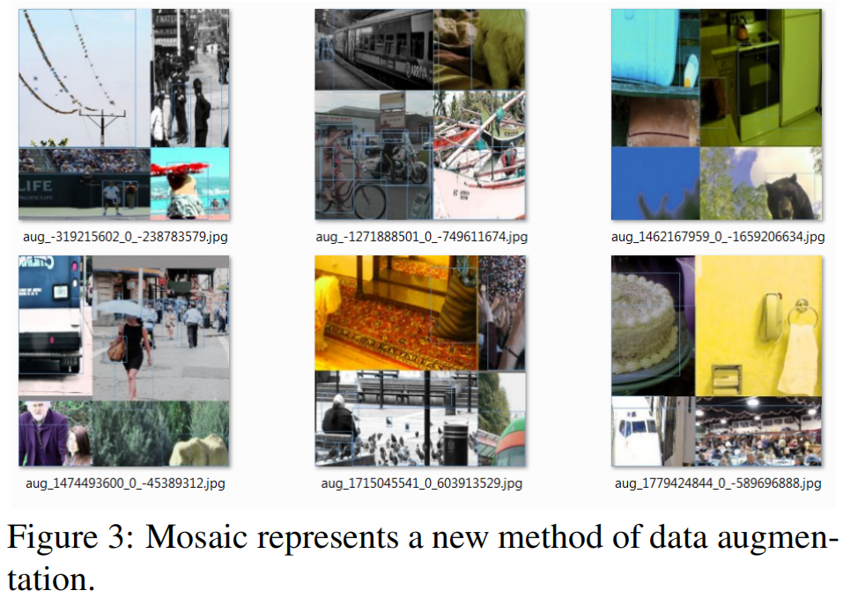
Data Processing
We used the Mosaic Augmentation technique from YOLO v4.
By combining data pairs from two datasets, enable the model to handle both tasks simultaneously.
Bochkovskiy, Alexey, Chien-Yao Wang, and Hong-Yuan Mark Liao. "Yolov4: Optimal speed and accuracy of object detection." arXiv preprint arXiv:2004.10934 (2020).

Slide 17
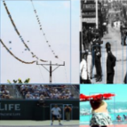
Data Processing
Due to the use of Mosaic Augmentation data processing, our RRNet is able to simultaneously address both issues.
Combining two dataset by Mosaic Augmentation
Concat mask and intput
Output

Slide 18
Conclusion
We propose a unified solution to address the common issues of mirror reflections and reflective flare in photography.
Our main contribution:
Propose a new FDNet to extract flare mask.
Apply Mosaic Augmentation to generate hybrid dataset.

Slide 19
Reference
[1] Zhu, Yurui, et al. "Revisiting Single Image Reflection Removal In the Wild." Proceedings of the IEEE/CVF Conference on Computer Vision and Pattern Recognition. 2024.
[2] Dai, Yuekun, et al. "Nighttime smartphone reflective flare removal using optical center symmetry prior." Proceedings of the IEEE/CVF Conference on Computer Vision and Pattern Recognition. 2023.
[3] Tan, Mingxing, and Quoc Le. "Efficientnet: Rethinking mode l scaling for convolutional neural networks." International conference on machine learning. PMLR, 2019.
[4] Chen, Liangyu, et al. "Simple baselines for image restoration." European conference on computer vision. Cham: Springer Nature Switzerland, 2022.
[5] Bochkovskiy, Alexey, Chien-Yao Wang, and Hong-Yuan Mark Liao. "Yolov4: Optimal speed and accuracy of object detection." arXiv preprint arXiv:2004.10934 (2020).

